Slide 1
Mood Detect Chih Wei Tung, Shanshan Zhao, Weixuan Jiang, Zhonghao Guo Team #2
Github Link: https://github.com/tungchihwei/EC601-Mood-Detect
Trello Link: https://trello.com/b/QZmTZ7UV/ec-601-final-project
Notes:
1

Slide 2
System Diagram
*
Patients (Local)
Server (Cloud)
Original sound files
Standardizedsound files
Pretreating
De-noising
Pretreating
De-noising
Extract
Signature
Extract
Signature
Pitch
MFCC
Formants
Pitch
MFCC
Formants
Signature
Pool
Machine Learning
(KNN)
Feedback
Psychiatrists (Local)
2
Notes:
Treatment: music, joke, comic, funny video

Slide 3
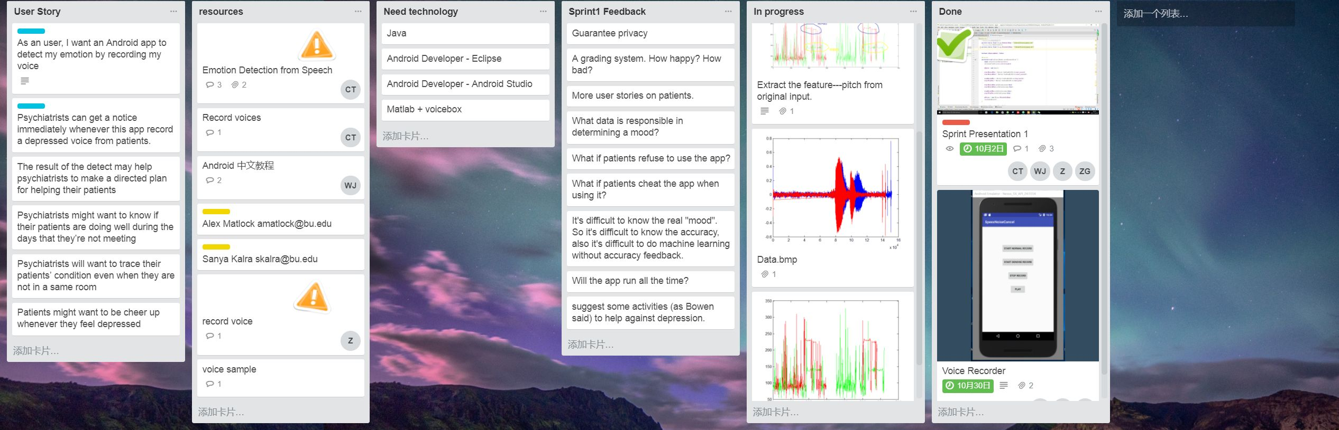
Trello Diagram
*
3

Slide 4
Accomplishments #1
*
Theoretical Background
Pitch, Mel Frequency Cepstral Coefficients(MFCCs) and Formants are extracted from human speech as features influence the recognition of emotions. ^{[1][2][3]}
Pitch is extracted from the speech waveform using RAPT algorithm implemented in the VOICEBOX toolbox.^{[4]}
MFCC parameters are calculated by STFT and DCT algorithm.^{[5]}
Using Linear Predictive Coding(LPC) to model formants.^{[6]}
K-Means Clustering and Support Vector Machines(SVM) ^{[7]}are adopted to classify opposing emotions.
4
Notes:
RAPT a robust algorithm for pitch tracking designed by Columbia University
STFT Short time fourier transform
Dct discret cosine transform

Slide 5
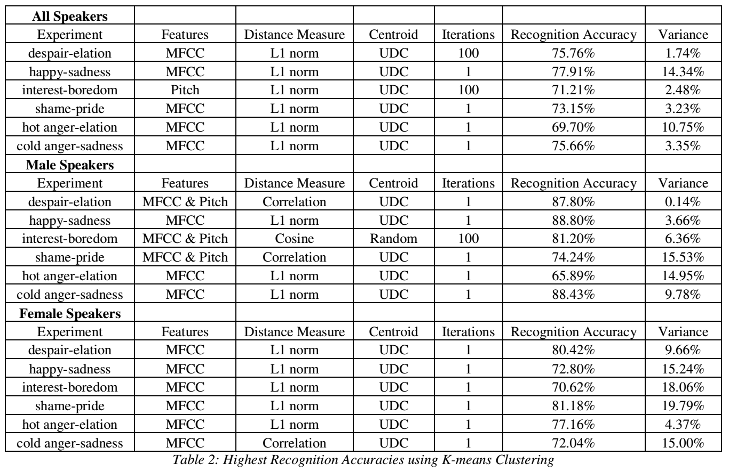
*
5
Notes:
No matter male or female speakers, the two opposing emotion pair can be accurately distinguished by those features listed above, so that we think the feature we choose is convincing.

Slide 6
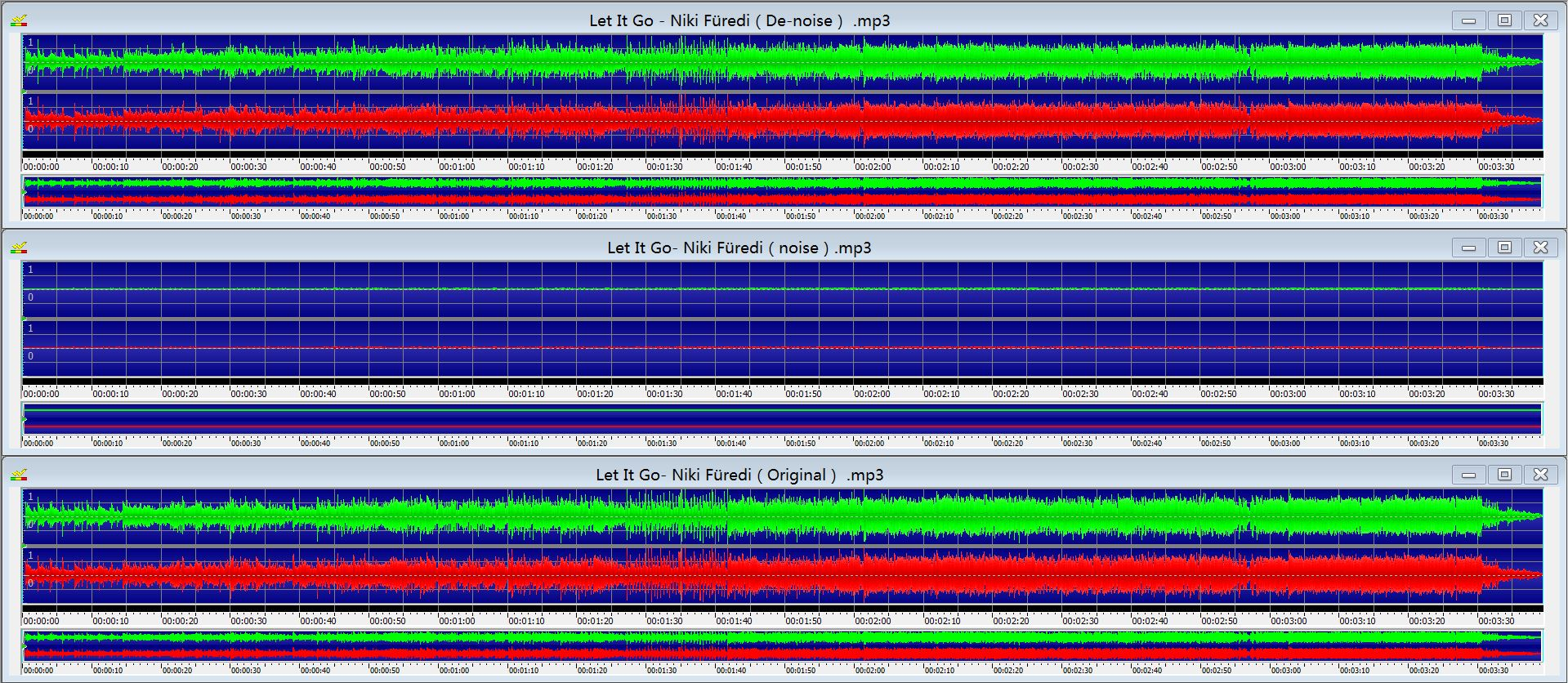
Accomplishments #2
*
De-noise Recorder
Build an demo to achieve voice recording
Noise elimination
6
Notes:
Let it go

Slide 7
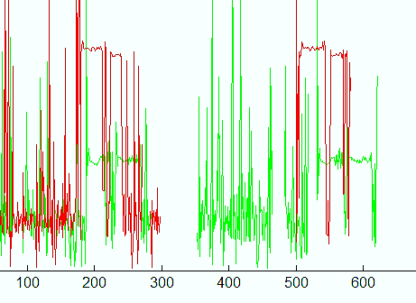
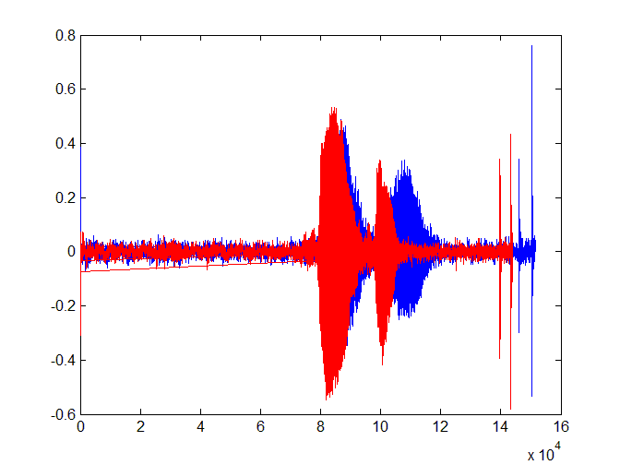
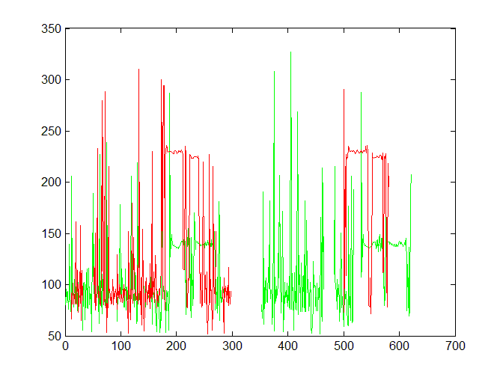
Accomplishments #3
*
Pitch Extraction
HAHA(calm)/HAHA(happy)
Pitch(calm)/Pitch(happy)
7
Notes:
Matlab toolbox-voicebox. fxrapt_—a robust algorithm for pitch tracking designed by Columbia University
Sample is “Haha”,we can see two peaks and two bars
The red bar is clearly higher than green bar, so we can say the pitch of happy voice is higher than calm voice.

Slide 8
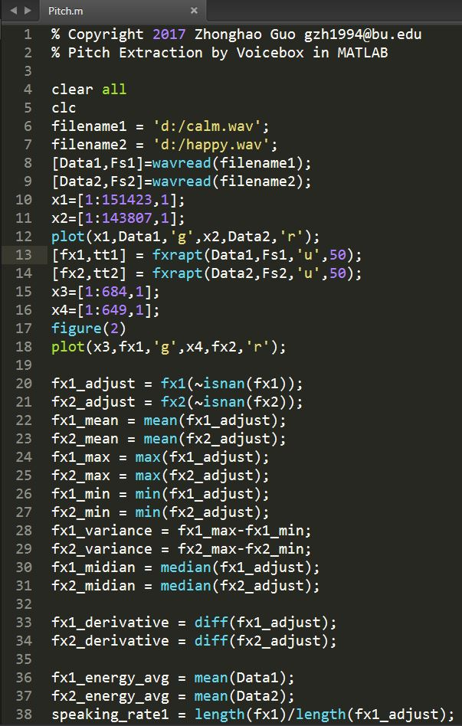
*
For the pitch vector and its derivative:
Mean
Median
Maximum
Minimum
Variance
Average energy of speech
Speaking rate
Inverse of the average length of the voiced part of the utterance
Hence, the pitch feature vector is
12-dimensional
8

Slide 9
Accomplishments #4
*
Emotional Prosody Speech and Transcripts^{[8]}
URL:https://catalog.ldc.upenn.edu/LDC2002S28
The recordings consist of professional actors reading a series of semantically neutral utterances (dates and numbers) spanning fourteen distinct emotional categories.
The content and emotion of each word and phrase is recorded in the matching transcript.
9
Notes:
This is the sample we gonna use in data training and prediction.
The file was cut to small pieces. Later, we will extract their features and put them into machines learning parts.

Slide 10
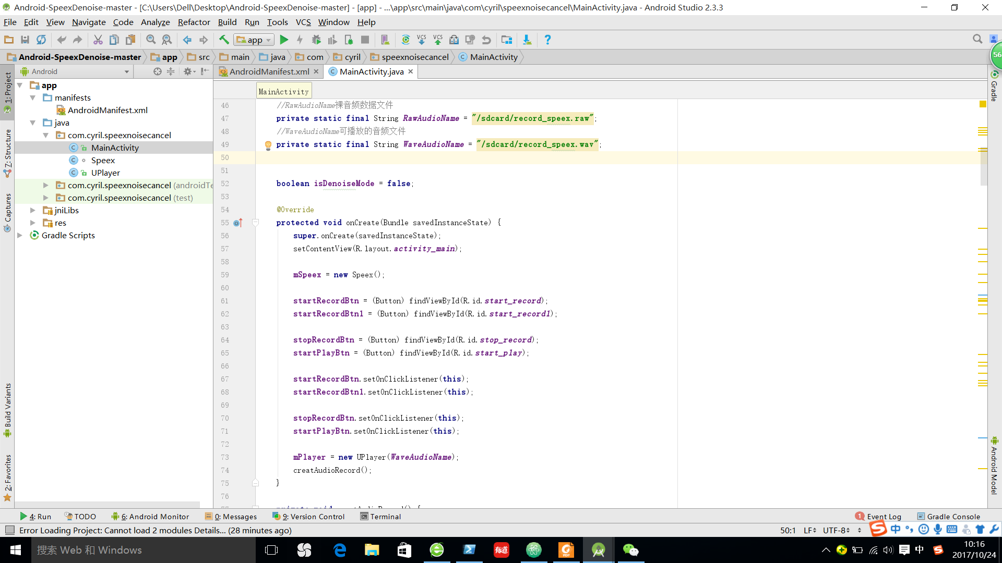
DEMO
*
10

Slide 11
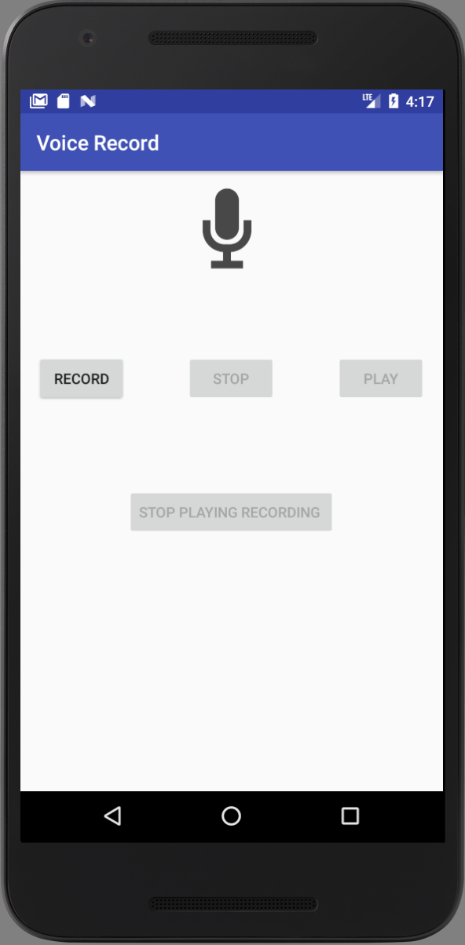
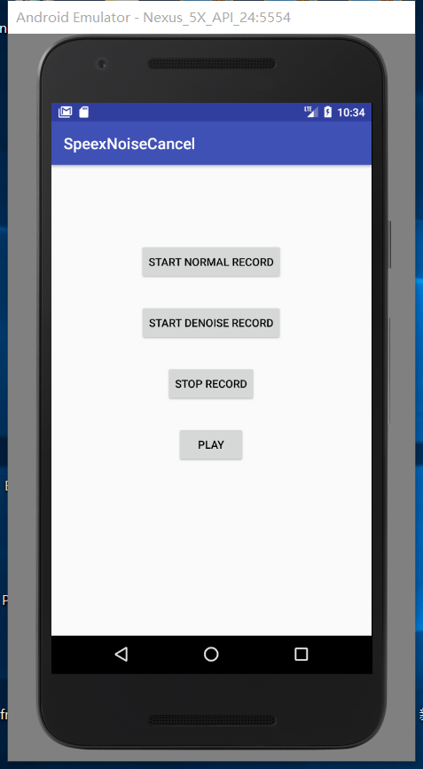
DEMO
*
Normal Recorder
Denoise Recorder
11

Slide 12
Challenges
*
User story——What if customers “cheat” the app when recording voice or even refuse to use it when feeling down?
Privacy Issue——If monitoring constantly, will the app offense user’s privacy?
Feedback Fraud——How to make sure the feedback from patients and psychiatrists are real? We may not get an objective training data set from subjective feedback.
Technical Challenges——How to transplant the RAPT toolbox from MATLAB to JAVA?
12
Notes:
Some of challenges come from feedback of sprint 1
1.patients——doctor, click agree when recording录音时点击同意，每处理完一句就删掉, 提取feature后删除掉源文件，只保留vector
2.

Slide 13
Next Sprint Plan
*
Extract signatures from original sound samples
Create multi-dimensional feature vectors from signatures acquired
Set up a dataspace to storage statistics
Upload all feature files to dataspace for Machine Learning
13

Slide 14
Reference
*
[1] Shah Hewlett, Emotion Detection From Speech, CS229, 2007.
[2] Garima Vyas, Malay Kishore Dutta, Automatic Mood Detection of Indian music Using MFCCs and K-means Algorithm, 2014.
[3] Sharifa Alghowinem, Roland Goecke, Michael Wagner, Julien Epps, Michael Breakspear, gordon Parker, From Joyous to Clinically Depressed: Mood Detection Using Spontaneous Speech, 2012.
[4] http://www.ee.ic.ac.uk/hp/staff/dmb/voicebox/voicebox.html
[5] http://www.ee.columbia.edu/~dpwe/resources/matlab/rastamat/
[6] L.R.Rabiner and B.H.Juang. “Fundamentals of Speech Recognition”, Upper Saddle River; NJ: Prentice-Hall, 1993
[7] http://ida.first.fraunhofer.de/~anton/software.html
[8] https://catalog.ldc.upenn.edu/LDC2002S28
14

Slide 15
THANK YOU
*
15

